Slide 1
GEOG 475 Advanced GIS Lab1
Zhenlei Song, Ph.D Student
Department of Geography
Email: songzl@tamu.edu
Office: CSA 301F

Slide 2
Part1.Tasks
Load Climate Station Point data and split into Training and Evaluating sets.
Apply interpolation algorithms on training set.
IDW
Cubic-Spline
Extract values from the interpolated layer onto the evaluating points.
Compare the predicted values and the ground truth by calculating RMSE
Tune params in interpolation, analyze the changes and interpret your findings.

Slide 3
Reading Before Lab
Creating a console tool
https://github.com/TAMUCIDI/GEOG-392-GIS-Programming/blob/main/Labs/Lab05/Lab05-pre01.md
Creating a ArcPy Toolbox
https://github.com/TAMUCIDI/GEOG-392-GIS-Programming/blob/main/Labs/Lab05/Lab05-pre02.md

Slide 4
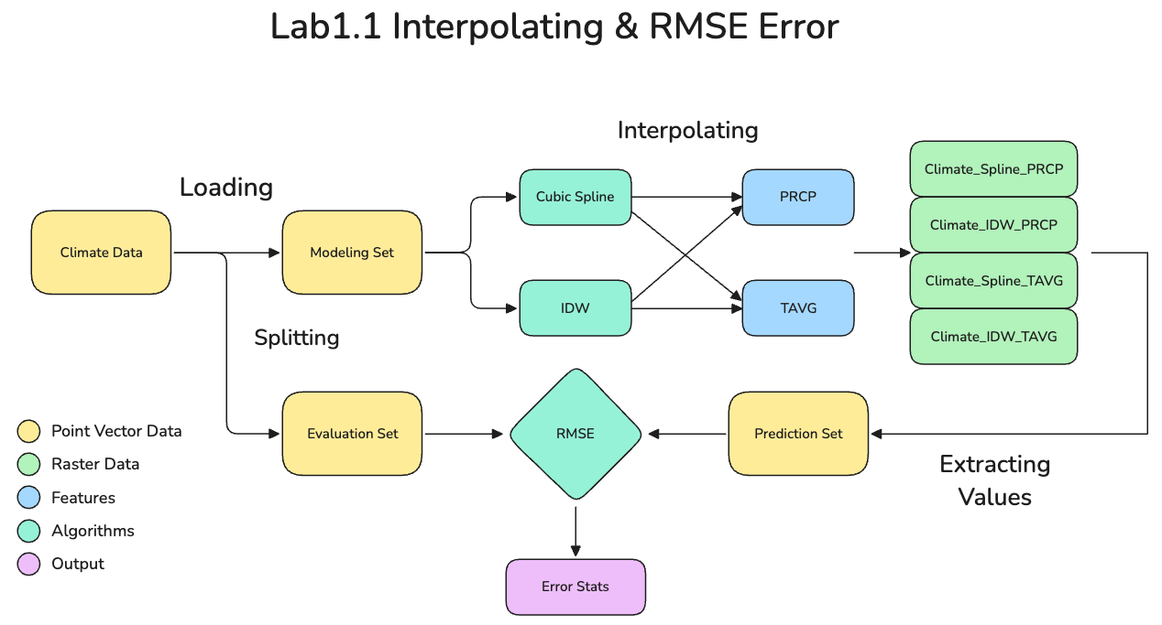
Part 1. Interpolation
Notes:
New python toolbox will ask you to generate a new XXX.pyt file with default templates.
Add toolbox can import your own XXX.pyt.

Slide 5
Submission
A PDF file in 2 parts:
Tool Part
A screenshot of all your codes.
A screenshot of the running result in the terminal.
A screenshot of the output feature in ArcGIS Pro.
Toolbox Part
A screenshot of all your codes.
A screenshot of the toolbox interface in ArcGIS Pro.
Screenshots of the running details of the toolbox. Both the success and the error messages.
And your Github Link

Slide 6
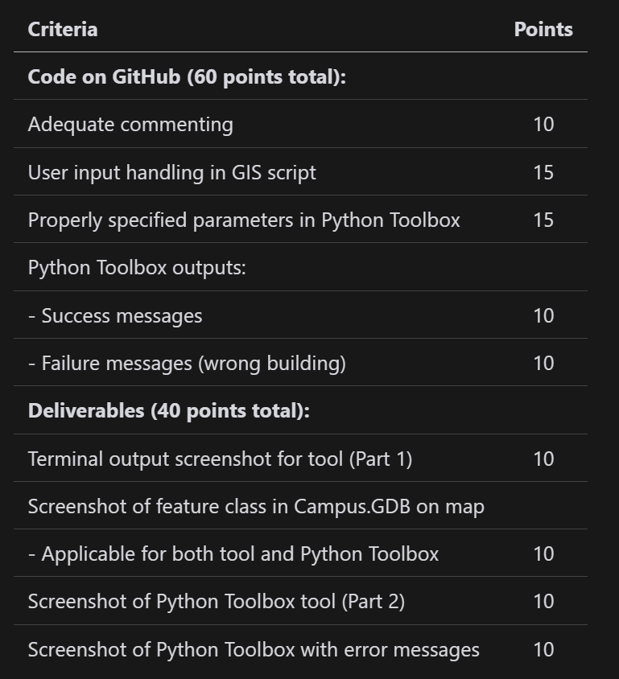
Grading Rule

Slide 7

Additional Resources
Useful Links
`Input()`
`arcpy.da.SearchCursor`
Arcgis parameter Docs
`arcpy.AddMessage`
VS Code Plugins
Python
Pylance
Python Debugger
Gitlens

Slide 8
The End

